Slide 1


National STEM Data – A Broad Perspective to Reaching SACNAS’ Mission
Sylvia Hurtado, Professor and Director
Higher Education Research Institute
UCLA
09.29.10

Slide 2
Projects:
Original NIH (2004): Promoting Diversity, Access, and Engagement
NSF (2008): Becoming Scientists: Practices in Undergraduate Education that Contribute to Degree Completion and Advanced Study in STEM Disciplines
Current NIH (2008): Post College Pathways: A Longitudinal Study of Biomedical and Behavioral Science Aspirations
ARRA (2009): Introductory STEM Courses: Sorting, Harvesting, or Nurturing Student Talent

Slide 3
Problem:
  STEM fields experience high attrition rates at various points in the educational pipeline
      Particularly URM students
      Affects expansion and diversity of STEM fields
      United States maintaining competitive standing as other countries gain in scientific innovation
  Lack of exposure to multiple career pathways at the graduate level
  Intersection of multiple identities while navigating degree completion (SACNAS helps with the intersection of identities)
  Integration of social science theories and conceptual models into practice

Slide 4
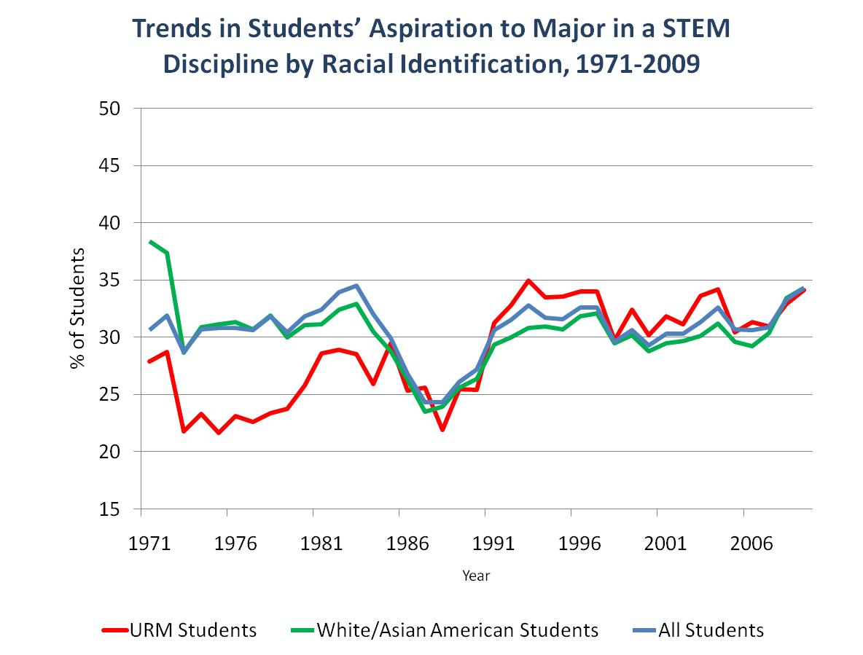
Opportunity Pool: Rising Interest in Science
Among Entering Freshmen

Slide 5
STEM Degree Completion Rates

Slide 6
What are we trying to understand?
  Role of introductory courses
  Efficacy of undergraduate research programs
  Best practices in STEM
  Institutional and academic major context
  Pathways to and through graduate school

Slide 7
2004 STEM Aspirants’ Plans

Slide 8
STEM Majors in the 4th Year

Slide 9
Grad Students: Lack of Exposure to Multiple Career Pathways
“When it comes to grad studies, I think, one question that needs to be asked is, do students feel like they're offered a variety of opportunities …how flexible is your program towards allowing you to choose other career paths? Is your program flexible in the light of today's realities for scientists?”
“I made the howling mistake a couple of years ago of mentioning that once I finished my PhD I was interested in teaching high school level biology at which point everyone decided, ‘Well, you don’t need a PhD so why are you still here?’”

Slide 10
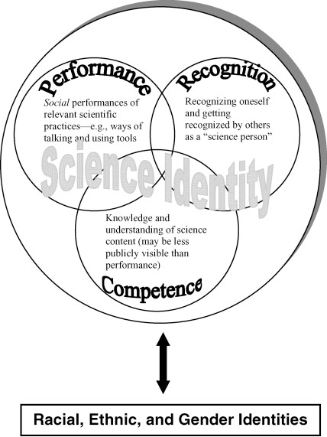
Source: Carlone & Johnson (2007).Journal of Research in Science Teaching, 44 (8).

Slide 11
Expanding Theory With Findings: Context Matters
Source: Focus groups of students in programs reported in Diversifying Science, Research in Higher Education (2009)
Competence
  Students talk about science differently in the classroom, in a professor’s project, or in a structured research program (peers, dedicated faculty)
Recognition
Institutional ethos – “We do science here”
Peer culture
Proximal contexts, faculty belief in students’ potential and determination to succeed
Emergent Results
Knowledge/content is to be mastered (memorized) versus knowledge can be discovered and “owned”
Science is competitive, getting right answers vs. collaborative using both challenge and support
More ways of demonstrating competence
Failure in scientific work is OK Rethink and try again until one succeeds
Validation from faculty and peers

Slide 12
GPA and Thinking/Acting Like a Scientist
Source: Introductory Course Work Study, 12 courses on five campuses
Students’ ability to cram for exams, previous preparation in high school, time spent working in small groups, and time spent tutoring another student positively predicted GPA
GPA was not significantly related to changes in thinking and acting like a scientist in courses
Students who were overwhelmed with course expectations not only had lower GPAs but were also less likely to think and act like a scientist
Implications: Are we assessing and recognizing the broader skills necessary for scientific work?

Slide 13
Findings on First-Year Retention for URM Students in the Biomedical and Behavioral Sciences
Connection to BBS discipline positively predicts BBS retention
Becoming more domain identified and having a frequency of negative racial experiences exacts a higher toll on URM students’ chances of persisting
Joining pre-professional/departmental club increases odds of BBS retention
Receiving advice from faculty about academic program increases chances of BBS persistence
Selective institutions negatively affect persistence

Slide 14
Findings on Four-Year Retention for URM Students in STEM
URM students and women of color had higher odds of STEM persistence STEM if they:
  joined student organizations related to their major
  discussed course content outside of class
  participated in undergraduate research programs
  Entered college with higher SAT scores
  Attended an institution with a higher concentration of STEM students
URM students and women of color had lower odds of STEM persistence STEM if they:
  Worked full-time while in college
  Initially aspired to earn a medical degree
  Attended a more selective institution

Slide 15
STEM Majors: Plans After College
Source: College Senior Survey
Only a quarter of URMs were going directly into graduate school in the fall of 2008, compared to a third of White/Asian students
One in five were applying to graduate school in the fall of 2008
Half were looking for a job or found a job
One in five were working in a job related to science, but only about 8% wanted scientific research as a long-term career

Slide 16
Predictors of Intentions to Enroll in Graduate School
URM STEM majors had higher odds of enrolling in graduate school if they:
  Came from more affluent backgrounds
  Earned higher cumulative GPAs in college
  Worked on a faculty member’s research project
  Had a stronger connection to STEM in their senior year
  Majored in the physical sciences (compared to engineering/computer science)
  Attended a private institution
  Attended an HBCU
URM STEM majors had lower odds of enrolling in graduate school if they:
  Relied on personal funds to finance their senior year of college
  Completed college with higher amounts of student loan debt
  Indicated that they had come to college to be able to make more money

Slide 17
Grad Students: Intersection of Identities
RACE: “I’m super visible and then at the same time I wanna be myself. …there’s not very many people of color in my department and so you’re always trying to figure out , ‘Okay, am I under a special kind of magnifying glass?’”
RELIGION: “…I feel like religion’s a very important thing to me. And there’s a huge tension there between like being someone who’s religious and being a scientist. Like a lot of people think those things are totally incompatible. And I couldn’t disagree more.”
FAMILY BACKGROUND: “So, I find myself often downplaying it with even extended family or when I go to my hometown hair salon. And they're like, wow, you're going to be a doctor, right? And I'm like, oh, it's no big deal. It's just a Ph.D. and it's just another degree. I find myself saying those types of things a lot, because I don't want other people who haven't had that opportunity in my family to feel that I feel that I'm better than them or anything like that.”

Slide 18
Intersection of Identities
  GENDER: “And I think you wear different hats depending on who you’re talking to. I think something I’ve been feeling recently is my female identity and my science identity. I was involved with a grant writing process and I’m 24 years old and female. And everyone else around the table were over 50 and white males. And I really, for the first time in my life I felt very different. And I think it’s interesting that I’m starting to feel the presence of a glass ceiling based on gender. And I’ve never felt that before. Which is ironic cause of our generation there are more women in science than men.”

Slide 19
Focus on Teaching
“I came in with a real focus on teaching, and then our program in fact discourages you from doing any teaching. We have to get permission if we want to even TA or assist in the lab. We have to get permission from our mentor and from the head of the graduate group. Most of the time, somebody says ‘no’ along the way.”
“I’d give it [the teaching] an ‘F’. I think it’s really, really bad. Very poor quality. I didn’t learn anything. It’s pretty obvious that most of our professors don’t really want to teach and that they don’t put in the time to even organize the class. “

Slide 20

RESOURCES & Project Staff
RESEARCH STAFF
Sylvia Hurtado, Co-PI
Mitch Chang, Co-PI
Postdoctoral Scholars
Kevin Eagan
Josephine Gasiewski
Graduate Assistants
Gina Garcia
Juan Garibay
Felisha Herrera
Monica Lin
Cynthia Mosqueda
Christopher Newman
Jessica Sharkness
Minh Tran
Papers and reports are available for download from project website
Project email: herinih@ucla.edu
Project website:
www.heri.ucla.edu/nih

